Slide 1


06
Game Theory
Samuel Lukas
A Guide to Game Theory by Fiona Carmichael, Prentice Hall, 2005
Introduction Game Theory and Its Applications
Elliott Mendelson, CRC Press Company, Washington DC.2004

Slide 2
Introduction
Game theory is a technique used to analyze situations of two or more individuals about the outcome of an action by one of them. It depends not only on the particular action taken by that individual but also on the action taken by the other.
Two firms with large market shares in a particular industry making decisions with respect to price and output
Leaders of two countries contemplating a war with each other
Players taking a penalty in association football
A tennis player deciding where to place a serve
Playing Chess, Card, four in row
Etc.

Slide 3
Some Terminologies
Strategic game
A scenario or situation where for two or more individuals have to chose their choice of action that has an impact on the other. It consists of a set of rules and their pay-offs
Strategic interdependence
Individual’s decisions, their choice about actions, impact or each other and therefore their decision making is interdependently related
Player
A participant in a strategic game
Strategy
A player’s plan of action for a game

Slide 4
Types of The Game
Simultaneous-move games
Sequential-move or dynamic games
Repetition games
Cooperative and non-cooperative games
N-Player games
Give some examples of each type of the game

Slide 5
Simultaneous-Move Games
Hide and Seek
Robin has only two available strategies, either hiding in the house or hiding in the garden. Tim has also two strategies, either looking in house or looking in garden. He has only 10 minutes to find robin. The table is Pay-off matrix for hide and seek above is
Robin \ Tim | Look in house | Look in garden
hide in house | 0 , 50 | 50 , 0
hide in garden | 50 , 0 | 0 , 50
This game considers as Pure Conflict Game. Because if the one wins the other effectively loses

Slide 6
Pub Managers
The King Pub head and Queen Pub head is going to introducing a special offer of their customers by cutting the price of their premium beer. Each decision will attract customers to come to the pub. Pay-off matrix for the pub managers’ game
Queen \ King head | Special offer | No offer
Special offer | 10 , 14 | 18 , 6
No offer | 4 , 20 | 7 , 8
What do you think each manager will do ?

Slide 7
Penalty taking
Assume at the last minutes, a football team has a penalty chance. If the striker make a goal than the his team will win the game and if the goal keeper saves the penalty then the score is draw. Pay-off matrix for the penalty taking game
Striker \ Gool keeper | Left | Centre | Right
Left | 0 , 10 | 10 , 0 | 10 , 0
Centre | 10 , 0 | 0 , 10 | 10 , 0
Right | 10 , 0 | 10 ,0 | 0 , 10
Pure conflict game

Slide 8
Sequential-move games
Players make moves in some sort of orders. This means one player moves first and other player or players see the first player’s move and respond to it. The game tree is represented as
2 , 2
Do you think
A will do promotion ? WHY
Promotion
B
Promotion
Not Promotion
6 , 3
A
3 , 6
Promotion
Not Promotion
B
Not Promotion
4 , 4

Slide 9
Other Type Games
Repetition
Games that are played by the same players more than once . It is also called as multi-stage or n-stage games
Cooperative and non-cooperative
The players are allowed to communicate and any agreements they make about how to play the game. Games, we will study, are non-cooperative games
N-Players
Number of players in a game is more than 2. The more the player the more complex the game will be

Slide 10
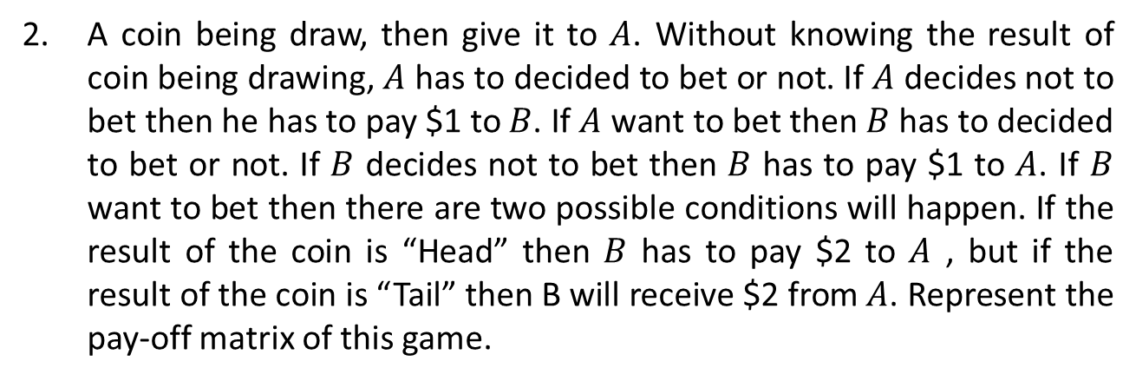
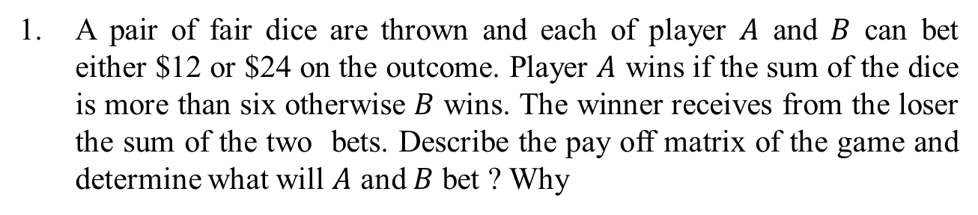
Exercises 01
1. A pair of fair dice are thrown and each of player $A$ and $B$ can bet either $12 or $24 on the outcome. Player $A$ wins if the sum of the dice is more than six otherwise $B$ wins. The winner receives from the loser the sum of the two bets. Describe the pay off matrix of the game and determine what will $A$ and $B$ bet ? Why
2. A coin being draw, then give it to $A$. Without knowing the result of coin being drawing, $A$ has to decided to bet or not. If $A$ decides not to bet then he has to pay $1 to $B$. If $A$ want to bet then $B$ has to decided to bet or not. If $B$ decides not to bet then $B$ has to pay $1 to $A$. If $B$ want to bet then there are two possible conditions will happen. If the result of the coin is “Head” then $B$ has to pay $2 to $A$ , but if the result of the coin is “Tail” then B will receive $2 from $A$. Represent the pay-off matrix of this game.

Slide 11
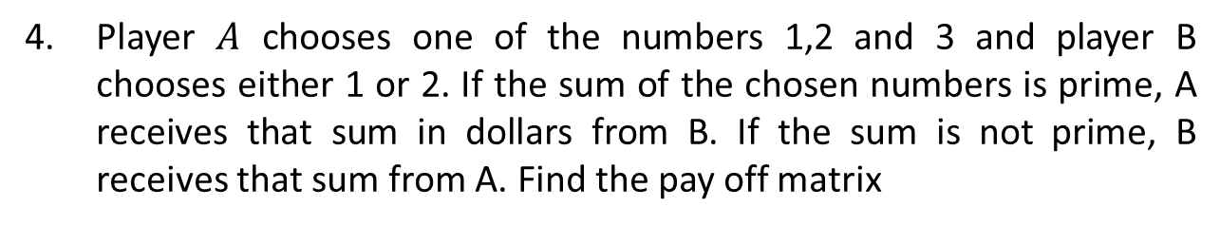
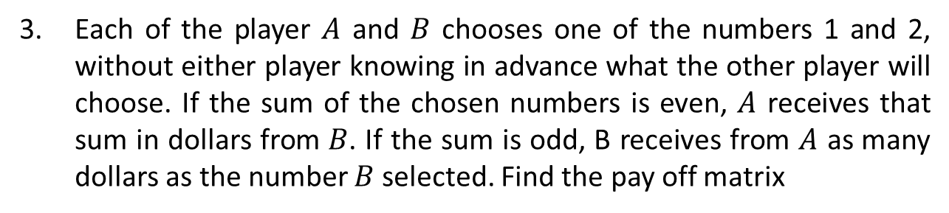
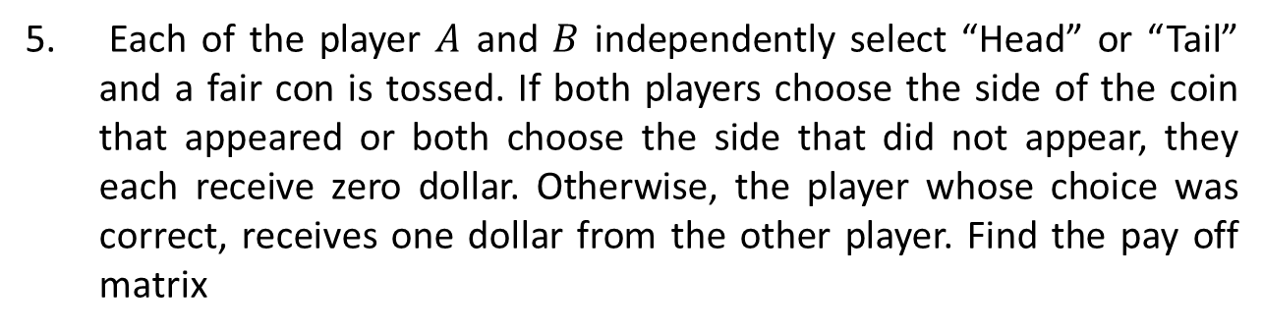
3. Each of the player $A$ and $B$ chooses one of the numbers 1 and 2, without either player knowing in advance what the other player will choose. If the sum of the chosen numbers is even, $A$ receives that sum in dollars from $B$. If the sum is odd, B receives from $A$ as many dollars as the number $B$ selected. Find the pay off matrix
4. Player $A$ chooses one of the numbers 1,2 and 3 and player B chooses either 1 or 2. If the sum of the chosen numbers is prime, A receives that sum in dollars from B. If the sum is not prime, B receives that sum from A. Find the pay off matrix
5. Each of the player $A$ and $B$ independently select “Head” or “Tail” and a fair con is tossed. If both players choose the side of the coin that appeared or both choose the side that did not appear, they each receive zero dollar. Otherwise, the player whose choice was correct, receives one dollar from the other player. Find the pay off matrix

Slide 12
6. Find the best move of each player with this pay -off matrix
Player 1 | Player 2
 | Strategy | 1 | 2 | 3 | 4
 | 1 | 7 | 2 | 9 | 4
 | 2 | 6 | 5 | 7 | 8
 | 3 | 8 | 3 | -2 | 6
7. Find the best move of each player with this pay -off matrix
Player 1 | Player 2
 | Strategy | 1 | 2 | 3 | 4
 | 1 | 4 | 3 | 5 | -1
 | 2 | 1 | 6 | 4 | 7
 | 3 | 2 | -3 | 8 | 9

Slide 13
Simultaneous Games Strategies
Strong Dominant – Strategy Equilibrium
Iterate-Dominance Equilibrium
Weak Iterated Dominance Equilibrium
Nash Equilibrium
Prisoner’s dilemma

Slide 14
Dominant – strategy equilibrium
A dominant strategy is a strategy that is the best response to all the possible strategy choices of all the other players.
A game will only have a dominant-strategy equilibrium if all players have dominant strategy.
Pay-off matrix for the pub managers’ game
A dominant strategy for Queen head is special offer and dominant strategy for King head is also special offer. WHY ?
Queen \ King head | Special offer | No offer
Special offer | 10 , 14 | 18 , 6
No offer | 4 , 20 | 7 , 8

Slide 15
Iterate-Dominance Equilibrium
Pay-off matrix iterated – dominance equilibrium game on attending to party or club
Does Ms Row or Mr Column have dominance strategy ?
Mr. Column has dominant strategy that is “attend to party” but Ms Row does not. So the game has no dominant strategy equilibrium. However, it does have a strong iterate-dominance equilibrium that is Ms Row attends to Club.
Ms Row \ Mr Column | Party | Club
Party | 1 , 3 | 2 , 0
Club | 2 , 2 | 1 , 1

Slide 16
Weak Iterated Dominance Equilibrium
Given Pay-off matrix of the game
Is there dominated strategy for A or B ?
If strategy Down is eliminated by A, then strategy Left for B is dominated then it is eliminated. It causes strategy Up for A is omitted and comes to the weak iterated dominance equilibrium to [Middle,Centre].
If weakly dominated strategy Middle is eliminated by A then strategy Centre for B is also eliminated. It causes strategy Up for A is omitted and comes to the weak iterated dominance equilibrium to [Down,Left] .
A \ B | Left | Centre | Right
Up | 3 , 6 | 2 , 6 | 1 , 7
Middle | 2 , 1 | 2 , 7 | 2 , 5
Down | 3 , 7 | 1 , 5 | 2 , 6
No … But

Slide 17
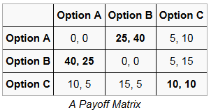
Nash Equilibrium
A best player’s move of a game involving two or more players effects second player‘s decision, and while second player’s best moving considers the first player’s decision. It means the decision of each player depends on other player’s decision.
For example :
There are three Nash Equilibrium cells. They are (A,B),(B,A) and (C,C)

Slide 18
Finding Nash Equilibrium
A combination of players’ strategies that are best responses to each other.
A \ B | LP | FP | EG
Lower price (LP) | 0 , 4 | 4 , 0 | 5 , 3
Free Printer (FP) | 4 , 0 | 0 , 4 | 5 , 3
Extended Guarantee (EG) | 3 , 5 | 3 , 5 | 6 , 6
If A strategy is LP then B is LP [LP,LP]
If A strategy is FP then B is FP [FP,FP]
If A strategy is EG then B is EG [EG,EG]
The Nash Equilibrium is [EG,EG]
If B strategy is LP then A is FP [FP,LP]
If B strategy is FP then A is LP [LP,FP]
If B strategy is EG then A is EG [EG,EG]

Slide 19
Prisoners dilemma
Two suspects are being interviewed by the police in relation to a major crime. They are being interviewed in separate cells and neither knows how the other’s interview is processing. The implicit assumption of the game is that the prisoners did in fact commit the crime that they are being questioned about. The suspects can either confess to the crime or deny they involvement in it. The pay-off matrix of this game is
P₁ \ P₂ | Deny | Confess
Deny | -1 , -1 | -10 , 0
Confess | 0 , -10 | -5 , -5
What do you think the prisoner’s strategy ?
Dominant strategy of this game is [Confess,Confess], however they prefer to [Deny, Deny]

Slide 20
Exercise 01
Do you think the game is a prisoners’ dilemma? WHY ?
1.
C₁ \ C₂ | Collude | Cheat
Collude | 7 , 7 | 3 , 10
Cheat | 10 , 3 | 5 , 5
Yes
2.
C₁ \ C₂ | Collude | Cheat
Collude | 7 , 40 | 3, 18
Cheat | 10 , 20 | 5 , 10
No
3.
Country 1 \ 2 | No Import Tariff | Impose Tariff
No Import Tariff | 10 , 10 | -1 , 15
Impose Tariff | 15 , -1 | 2 , 2
Yes
4.
Country 1 \ 2 | No Import Tariff | Impose Tariff
No Import Tariff | 10 , 10 | -1, 8
Impose Tariff | 8 , -1 | -2 , -2
No

Slide 21
Given this pay-off game. Find the decision of each?
5.
A \ B | No Tariff | Impose Tariff
No Tariff | 10 , 10 | -1 , 8
Impose Tariff | 15 , -1 | 2 , -2
6.
A \ B | Hold Out | Confess
Hold Out | -3 , -3 | -8 , -2
Confess | -2 , -8 | -6 , -6

